Slide 1
Bank repl
Dennis Keithly

Slide 2
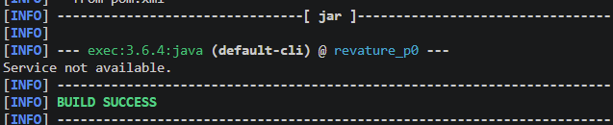
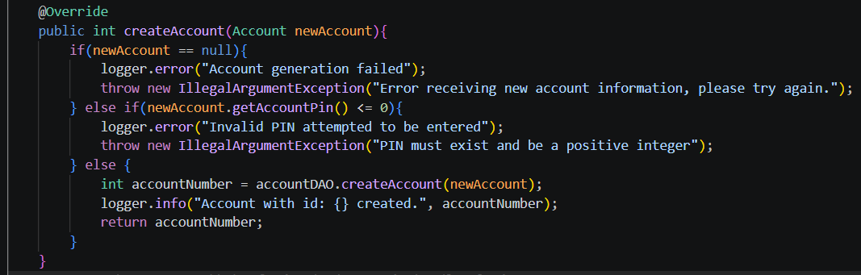
Multilayer
This bank repl application utilizes clean code principles:
Api layer
Service Layer
Persistence Layer
Domain Layer

Slide 3
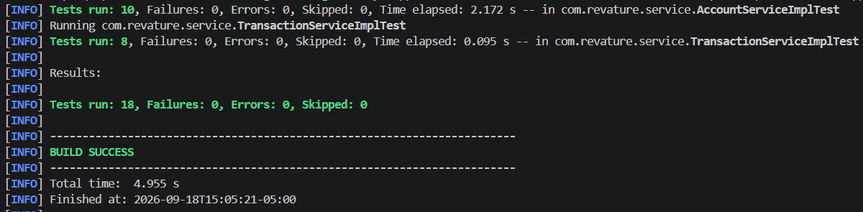
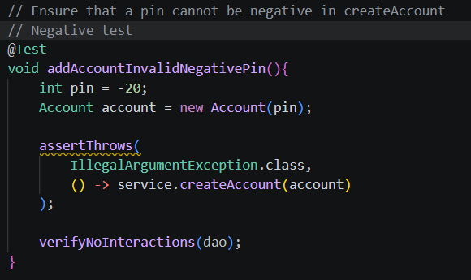
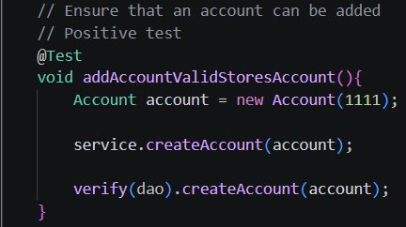
Unit tests
Unit testing is done using Junit, Jupiter, and Mockito

Slide 4
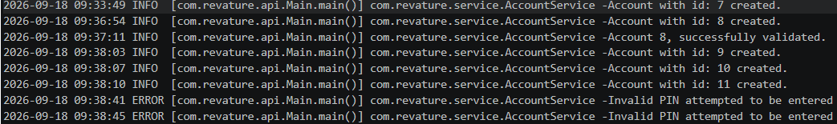
Logging
Logback is the method of logging. Most logging is done on the service layer, with an exception inside the ConnectionFactory to notify of database loss.

